Slide 1
File Input and Output

Slide 2
The File Class
The File Class
The filename is a string.
The File class is a wrapper class for the file name and its directory path.
The File class does not contain the methods for reading and writing file contents.

Slide 3
Relative vs. Absolute Paths
Relative vs. Absolute Paths
An absolute file name contains the complete path and drive letter. For example:
c:\book\Welcome.java (in Windows)
/home/inelson/book/Welcome.java (in UNIX)
A relative file name is in relation to the current working directory. For example:
Welcome.java

Slide 4
Which Filename to use?
Which Filename to use?
Do not use absolute filenames in your program.
So use relative filenames for school projects.
Your program will not be portable to other platforms.

Slide 5
Common methods for obtaining file properties and manipulating files
java.io.File | Description
+File(pathname: String) | Creates a new File instance by converting the given pathname string into an abstract pathname.
+File(parent:String, child:String) | Creates a new File instance from a parent pathname string and a child pathname string.
+File(parent:File, child:String) | Creates a new File instance from a parent abstract pathname and a child pathname string.
+exists(): boolean | Tests whether the file or directory denoted by this abstract pathname exists.
+isFile(): booloean | Tests whether the file denoted by this abstract pathname is a normal file.
+getPath(): String | Converts this abstract pathname into a pathname string.
+Length(): long | Returns the length of the file denoted by this abstract pathname.

Slide 6
Text I/O
Text I/O
In order to perform I/O, you need to create objects using appropriate Java I/O classes.
The objects contain the methods for reading/writing data from/to a file.
One way to read/write strings and numeric values from/to a text file is to use the Scanner and PrintWriter classes.

Slide 7
Write using a PrintWriter object:
Write using a PrintWriter object:
PrintWriter output = new PrintWriter(filename);
Check if the file exists before you write anything.
Then, you can invoke the print, println and printf methods to write data to a file. These are the same methods that are used to write to the Console.
You must close the file after writing. Otherwise, the data may not be properly saved in the file.

Slide 8
Write Data using a PrintWriter
Write Data using a PrintWriter
Construct a PrintWriter Object:
PrintWrite writer = new PrintWriter(filename);
Use printing methods similar to System.out.print
println
print
printf

Slide 9
Example of Creating a PrintWriter
public class WriteData {
public static void main(String[] args) throws Exception {
java.io.File file = new java.io.File("scores.txt"); //new File object
if (file.exists()) {
System.out.println("File already exists")
System.exit(0);
}
//create an PrintWriter object
java.io.PrintWriter output = new java.io.PrintWriter(file);
// Write formatted output to the file
output.print("John T Smith ");
output.println(90);
output.close(); // Close the file
}

Slide 10
Reading using Scanner
Reading using Scanner
Construct a Scanner object:
Scanner input = new Scanner(new File(filename));
A Scanner breaks its input into tokens delimited by whitespace characters.
Scanner tokens are read by token-reading methods like nextInt(), nextDouble() and next().
Methods such as nextInt() convert the token into the appropriate value. next() does not, and may throw an exception if the token does not match the expected type (String).

Slide 11
Reading Strings
Reading Strings
Using next() to read a String will read to the next delimiter. It is a token-reading method.
Using nextLine() will read a line ending with a line separator.
The line separator in Windows is \r\n ane in UNIX, it is \n. The enter key corresponds to \n.
The token reading method will not read the delimiter after the token. If the delimiter is a line separator, that can be a problem.

Slide 12
Scanner can act like cin in C++
Scanner can act like cin
in C++
If you read an int with
String string = input.nextLine();
To get the \n out of the input stream, use another
input.nextLine(); (like cin.ignore();)
after reading the int. It will read the \n and you are good to go.
the \n is left in the input stream.
input.nextInt(),
If you attempt to read a string, like
you will only read the \n. Sound familiar?

Slide 13
Read Data using a Scanner
Read Data using a Scanner
Construct a Scanner Object:
Scanner reader = new Scanner(String filename);
Use reading methods similar to Scanner(System.in)
next
nextInt
nextLine
or new Scanner(File objectName);
Check for next token:
hasNextLine or hasNext

Slide 14
Example of Reading Data
public class ReadData {
public static void main(String[] args) throws Exception {
java.io.File file = new java.io.File("scores.txt"); // Create a File instance
Scanner input = new Scanner(file); // Create a Scanner for the file
// Read several items of data on one line from a file
while (input.hasNext()) {
String firstName = input.next();
String lastName = input.next();
int score = input.nextInt();
System.out.println(
firstName + " " + mi + " " + lastName + " " + score);
}
input.close(); // Close the file
}
}

Slide 15
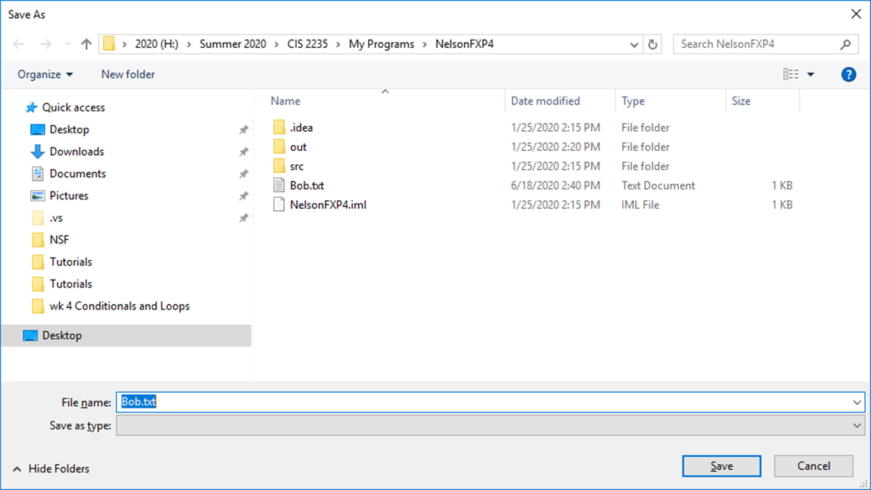
GUI File Dialogs – A Save File Example

Slide 16
Read Using a File Chooser Dialog
Read Using a File Chooser Dialog
Create a FileChooser object:
FileChooser filechooser = new FileChooser();
Use the showOpenDialog(null) method to displays dialog box.
Read the data in the file using a scanner, etc.
Finally, close the file.
Select a file.
The Dialog Box returns an int, either APPROVE_OPTION OR CANCEL_OPTION, telling which button was clicked.
Check to file to see if it is null.

Slide 17
Example of using FileChooser to Read Data
public class ReadFileUsingFileChooser {
public static void main(String[] args) throws Exception {
FileChooser fileChooser = new FileChooser(); //new FileChooser obj
File currentDirectory = new File(System.getProperty("user.dir"));
fileChooser.setInitialDirectory(currentDirectory);
File file = fileChooser.showOpenDialog(null);
Scanner input = new Scanner(file); // Create a Scanner for the file
// Read text from the file
while (input.hasNext()) {
System.out.println(input.nextLine());
}
input.close(); // Close the file
} else { System.out.println("No file selected"); } } }

Slide 18
Write Using a File Chooser Dialog
Write Using a File Chooser Dialog
Create a FileChooser object:
FileChooser filechooser = new FileChooser();
Use the showSaveDialog(null) method to displays dialog box.
Write the data in the file using a PrintWriter.
Finally, close the file.
Select a file.
The Dialog Box returns an int, either APPROVE_OPTION OR CANCEL_OPTION, telling which button was clicked.
Check to see if it already exists
fileChooser.setInitialDirectory(new File(“.”));
File currentDirectory = new File(System.getProperty(“user.dir”);

Slide 19
Example of using FileChooser to Write Data
public class WriteFileUsingFileChooser {
public static void main(String[] args) throws Exception {
FileChooser fileChooser = new FileChooser(); //new FileChooser obj File
File currentDirectory = new File(System.getProperty("user.dir"));
fileChooser.setInitialDirectory(currentDirectory);
file = fileChooser.showSaveDialog(null);
if(file != null) //Check to see if file chosen is null
PrintWriter out = new PrintWriter(file); // Create a PrintWriter for the file
// Write text to the file
out.println( someMessage);
out.println(number);
out.close(); // Close the file
}
else {
System.out.println("No file written"); }}}

